Slide 1
Ten-Year Stroke Risk in the Framingham Heart Study
Kayla Robledo April 22nd, 2026
Project 3

Slide 2
Research Questions
Primary Objectives:
What other factors besides age, systolic blood pressure, and diabetes are associated with 10-year stroke risk for males and females?
Other factors of interest: body mass index, prevalent coronary heart disease, serum total cholesterol, smoking status, anti-hypertensive medication use
What is the 10-year stroke risk for the following risk profiles stratified by sex and ages 40, 50, and 60:
Healthy
High systolic blood pressure
Diabetic
High systolic blood pressure and diabetic
An analyst-defined profile
Secondary Objective:
Do systolic blood pressure and diabetes for males and females change across collection periods and what is the magnitude of this change?

Slide 3


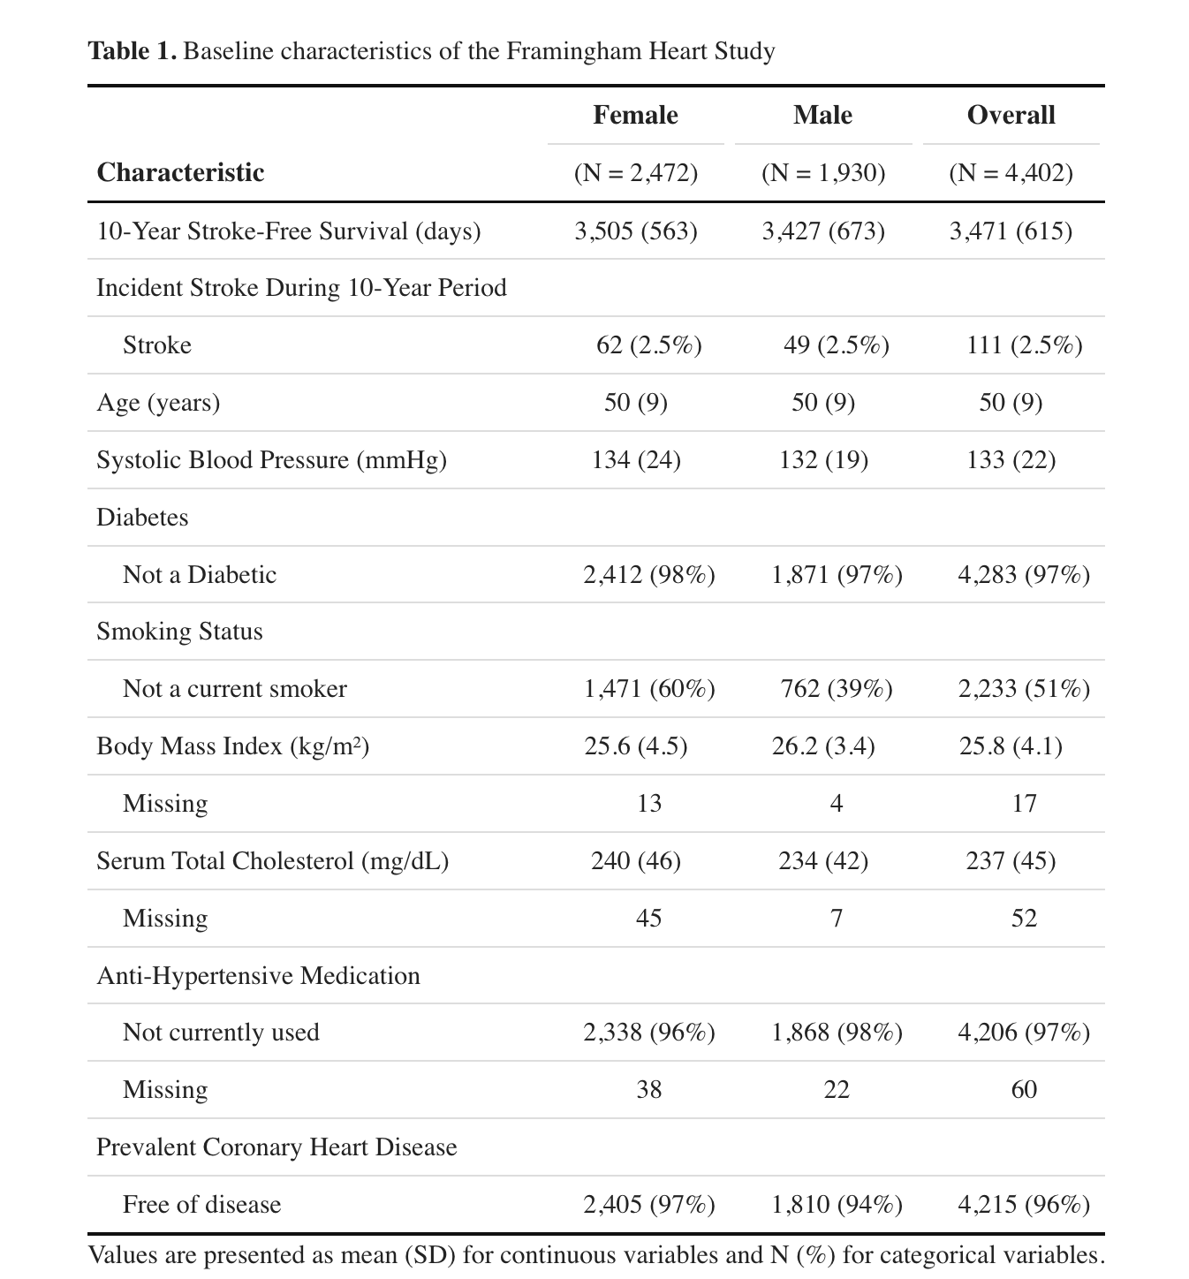

Data Overview
5,209 individuals (original) → 4,434 (cohort) → 4,402 (final)
Excluded those with baseline stroke
Follow-up time was set to 10-years (3,625.5 days)
Deaths occurring before the 10-year period without a reported stroke were censored
Stroke event occurring after the 10-year period were censored

Slide 4
Analysis
Stratified by sex
Primary Analyses
Visualize Kaplan-Meier curves to understand the unadjusted relationship between 10-year stroke-free survival and the covariates of interest
Age, serum total cholesterol, and body mass index were categorized at the population median
Systolic blood pressure was categorized into high (≥160 mmHg) and its counterpart
Cox proportional hazard models were fit using Akaike information criterion (AIC) backwards selection using complete case analysis
Using the final model and complete case analysis of the selected variables, compute the risk profiles for 10-year stroke risk estimates and choose a risk profile based on the additional covariate(s)
Secondary Analysis
Report descriptive statistics stratified by period and compute the percent change in means/proportions where ≥10% indicates a clinically meaningful difference

Slide 5
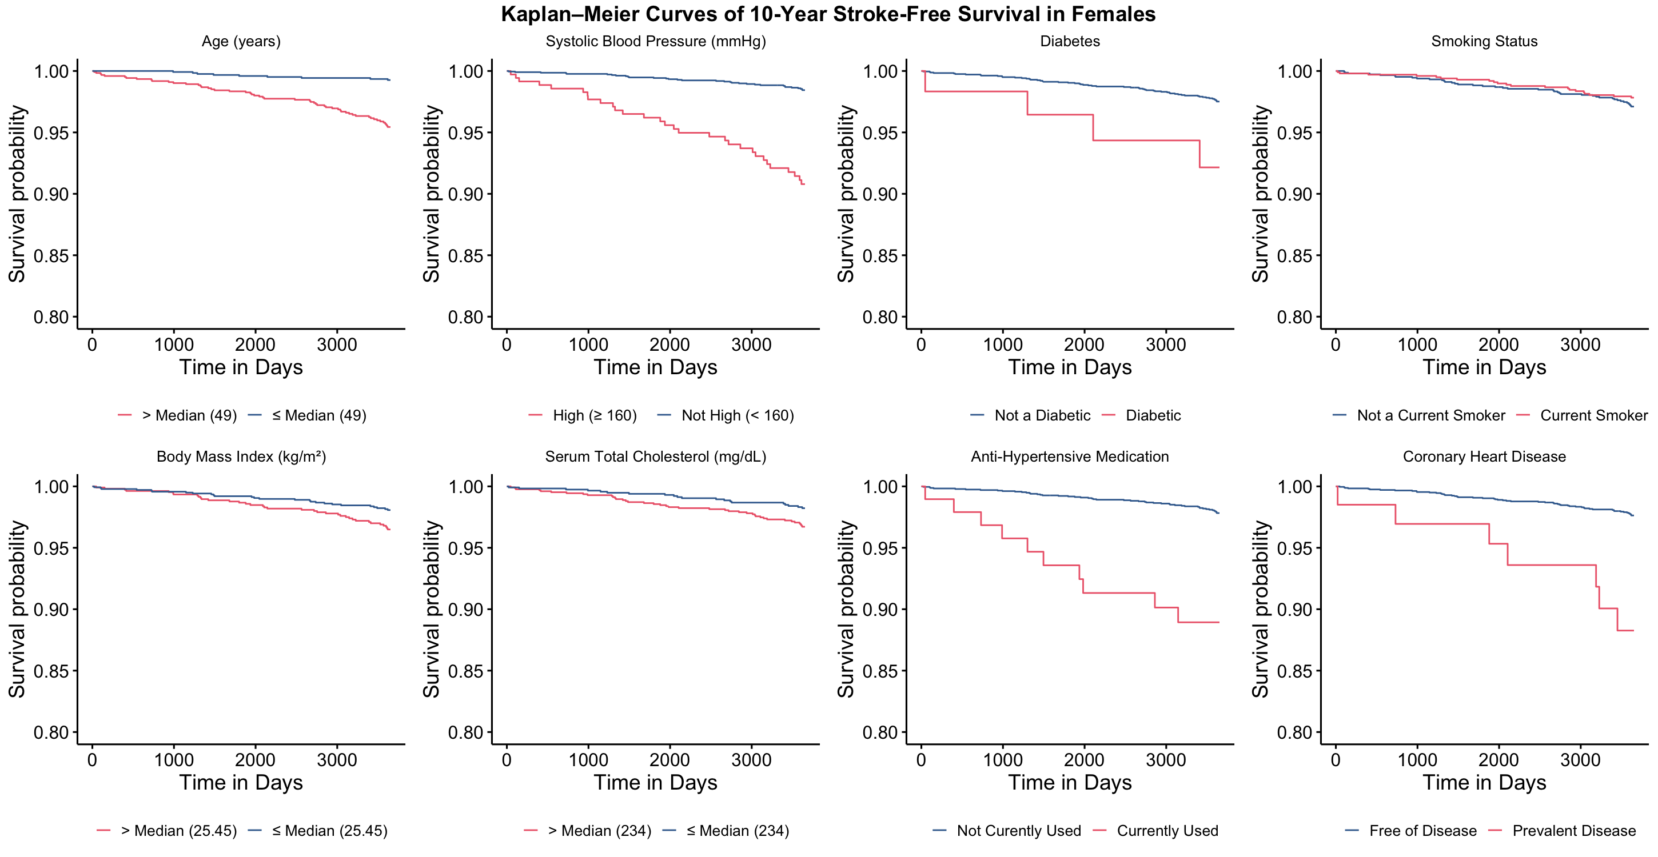
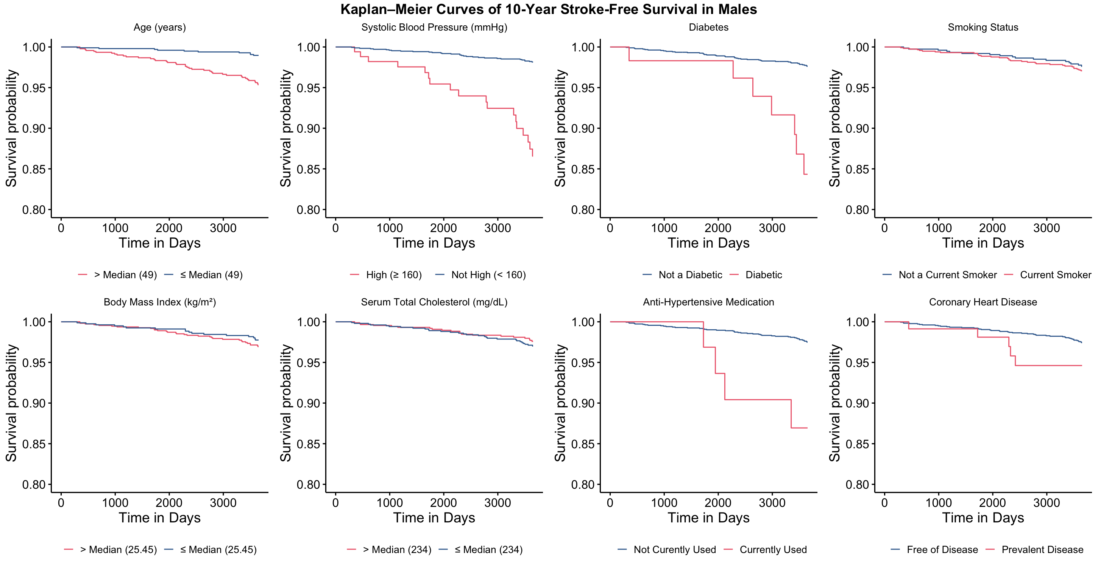

Slide 6
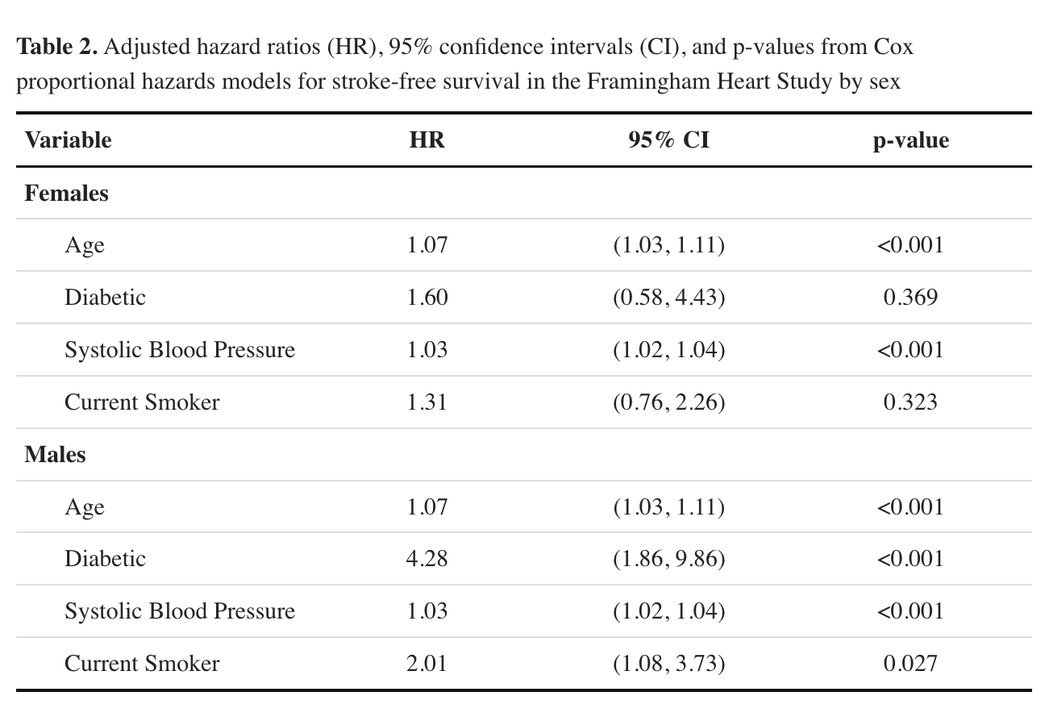
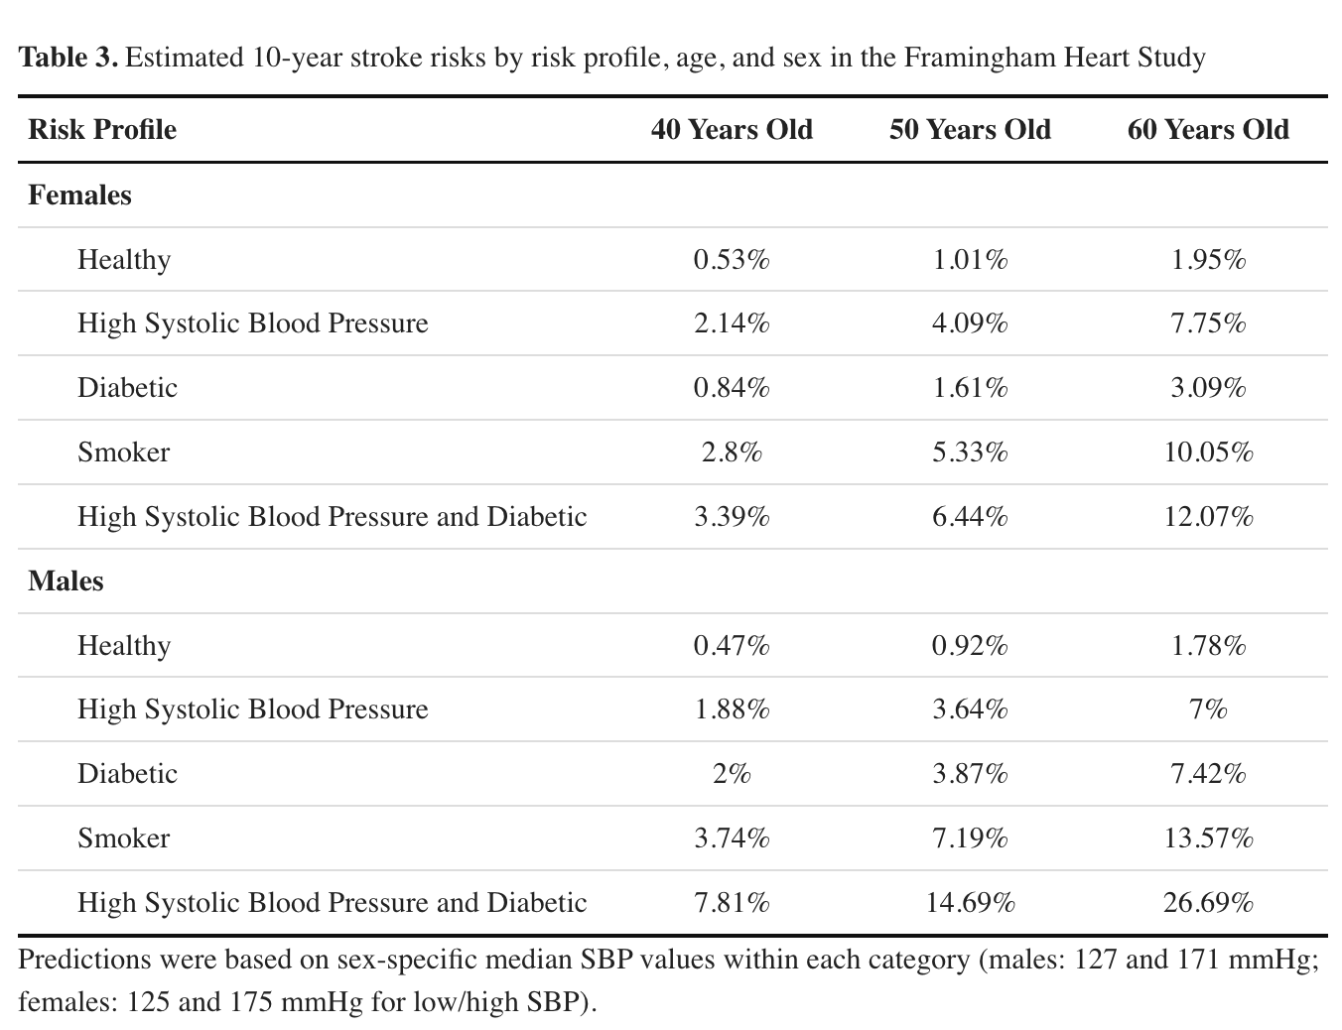
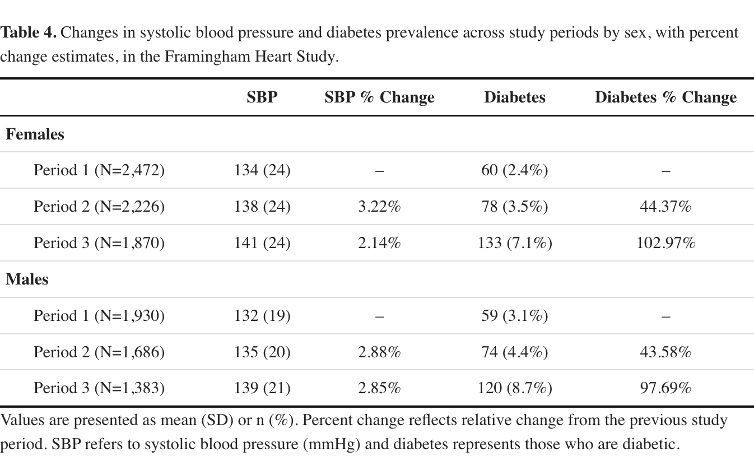

Slide 7
Discussion
Conclusions:
Smoking status, in addition to age, systolic blood pressure, and diabetes, was associated with 10-year stroke risk in both sexes
Stroke risk increased with increasing age and number of risk factors
Systolic blood pressure remained relatively stable over time, whereas diabetes prevalence increased substantially across study periods in both sexes
Potential time-varying effect of diabetes
Limitations:
Restriction to baseline covariates does not account for time-varying changes in risk factors
Time-varying covariates may better capture changes in risk factor status or timing and can lead to different effect estimates
Other non‑fatal cardiovascular events were not modeled as competing risks
AIC-driven backward selection using complete case analysis may introduce model instability, overfitting, and selection bias
Lack of interaction terms may limit detection of effect modification

Slide 8
Questions?

